Slide 1


Phishing Link Detection System
TU Final Defense of Project-II – CAPJ356
Prepared By
[6-2-530-26-2020 | Rojina Ghimire ]

Slide 2
Table of Contents
Introduction
Problem Statement
Objectives
Scope & Limitations
Methodology
Literature Review
Feasibility Study
Functional Requirements
Non functional Requirements
Tools and Technology
Diagrams
Algorithm Details
Result Analysis
Conclusion
References

Slide 3
Introduction
Phishing sites are primary way for hackers to steal information. They mimic the look and feel of authentic websites to trick users.
This project aims to detect and warn users of phishing sites.
Makes use of publicly available dataset to train a phishing detection model.

Slide 4
Problem Statement
Phishing continues to pose significant threats targeting individuals and organizations worldwide
Leads to financial losses and identity theft
Current cybersecurity measures are often reactive and less effective against evolving techniques

Slide 5
Objectives
To develop a phishing link detection system using machine learning
To enhance online security by accurately identifying and blocking malicious URLs in real-time

Slide 6
Scope
This is an end-to-end machine learning application that provides a user-friendly interface for submitting URLs and receiving phishing detection results
To integrate the detection system with existing cybersecurity frameworks for enhanced protection
To continuously update and refine the system to adapt to new phishing tactics and threats

Slide 7
Limitations
Limited to detecting only phishing URLs and may not identify other forms of cyber threats
It may not accurately detect new or highly sophisticated phishing techniques
Potential for false positives and false negatives, which could affect the accuracy and reliability of the system

Slide 8
Methodology
Develop the system using HTML, CSS and JavaScript for frontend and python and dataset for backend.
This project adopted V-model (Verification and Validation) model
Uses LSTM (Long Short-Term Memory) Algorithm
11/24/2024

Slide 9
Literature Review
PhishShield:
- Uses Random Forest to detect phishing URLs.
- Extracts features like domain age, URL length, and special characters
EasyDMARC
- Uses LSTM neural network to analyze sequential patterns in URLs
- Detects subtle anomalies indicative of phishing.
Comparison:
- PhishShield: Traditional machine learning (feature extraction).
- EasyDMARC: Deep learning (pattern recognition with LSTM).

Slide 10
Functional Requirements
The system shall allow users to enter url for analysis.
The system shall analyze url that is entered by user in real time to detect phishing links.
The system shall view result and warn the users about the sites.

Slide 11
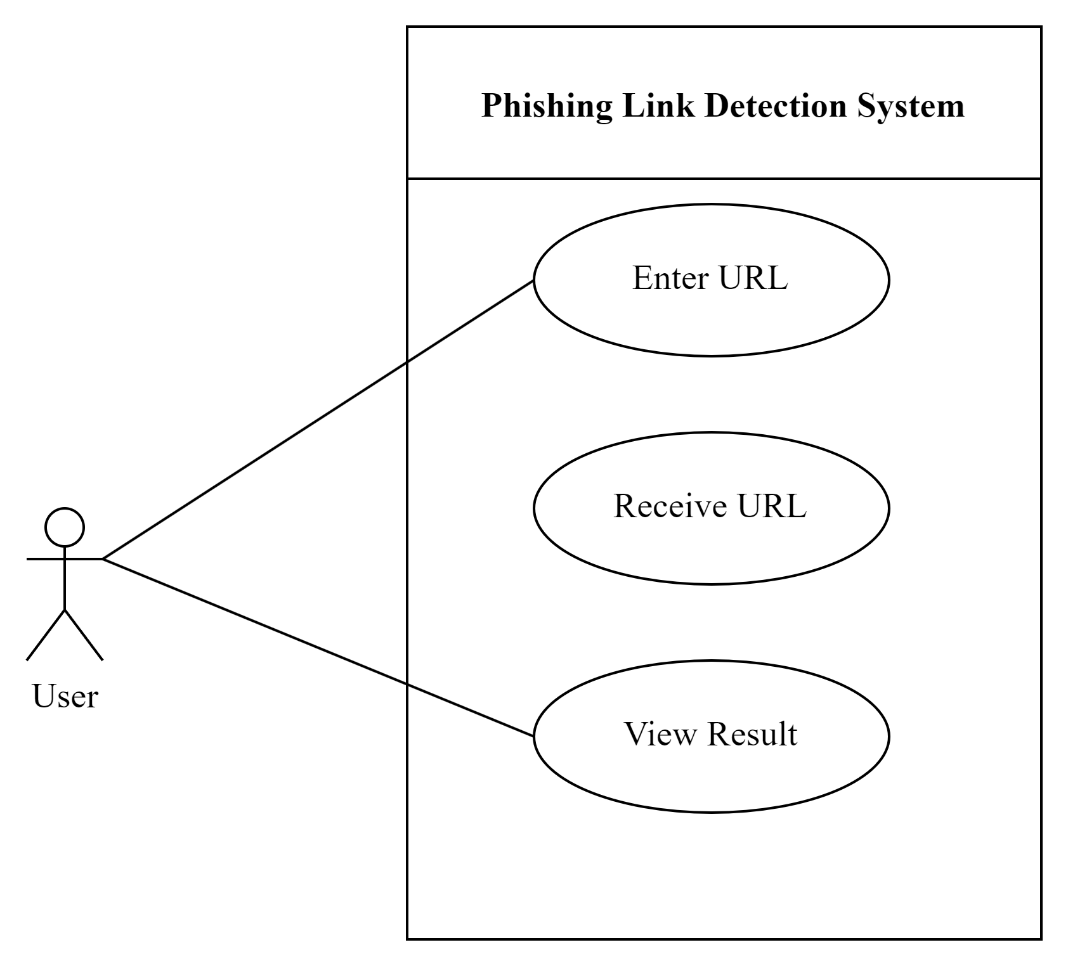
Use Case Diagram

Slide 12
Non-functional Requirements
The system must have an intuitive UI
The system must be secured
The system must have a good response

Slide 13
Feasibility Study
Technical feasibility
Operation Feasibility
Economical Feasibility
Schedule Feasibility
11/24/2024

Slide 14
Tools and Technology
Front end: Html, Css, Javascript
Back end: Python
Other tools: Draw.io
FastAPI

Slide 15
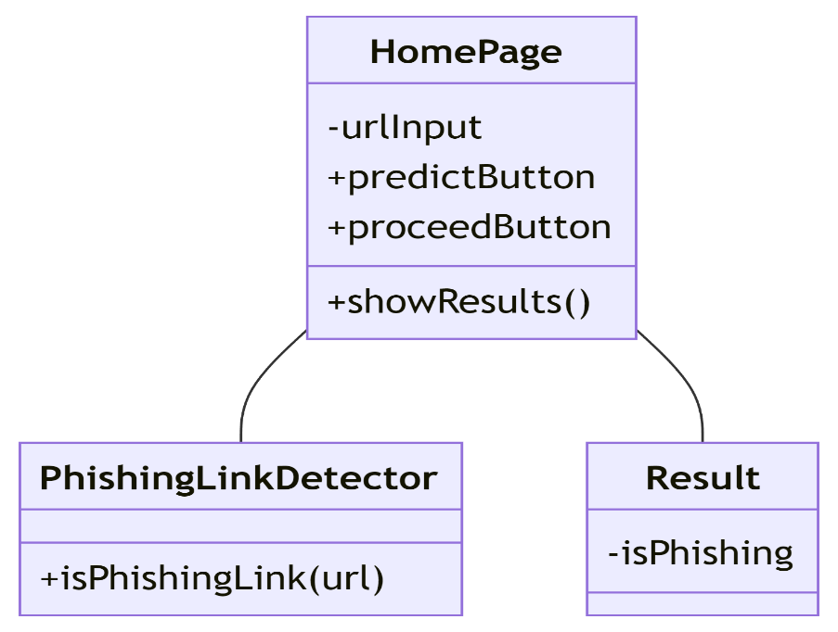
Diagrams:Class Diagram
11/24/2024

Slide 16
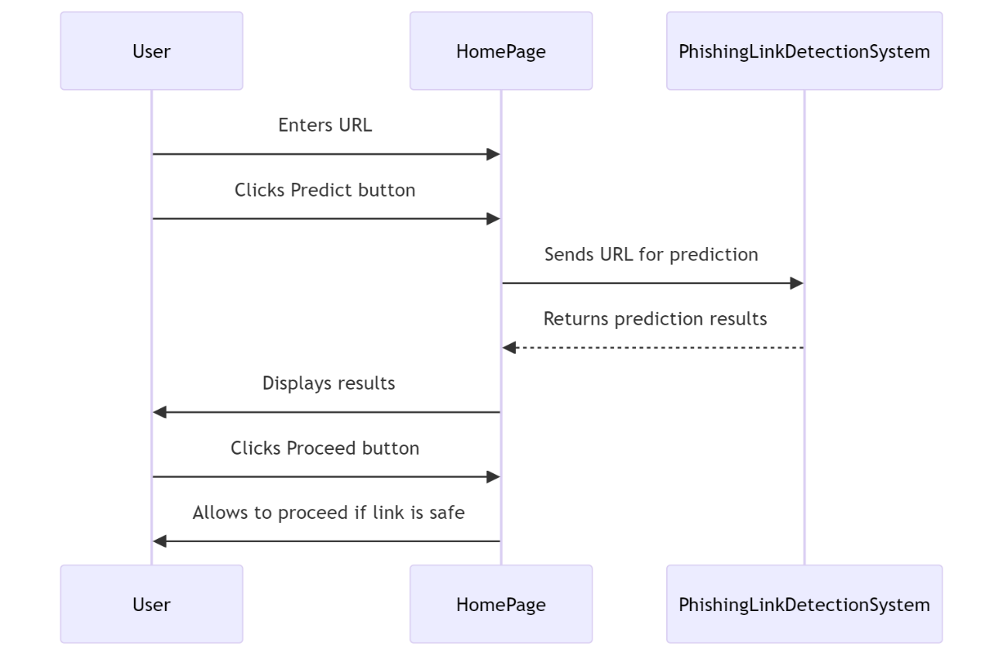
Sequence Diagram
11/24/2024

Slide 17
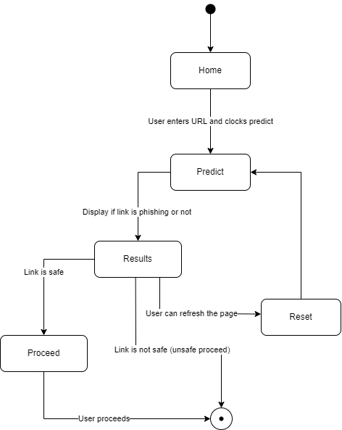
State Diagram
11/24/2024

Slide 18
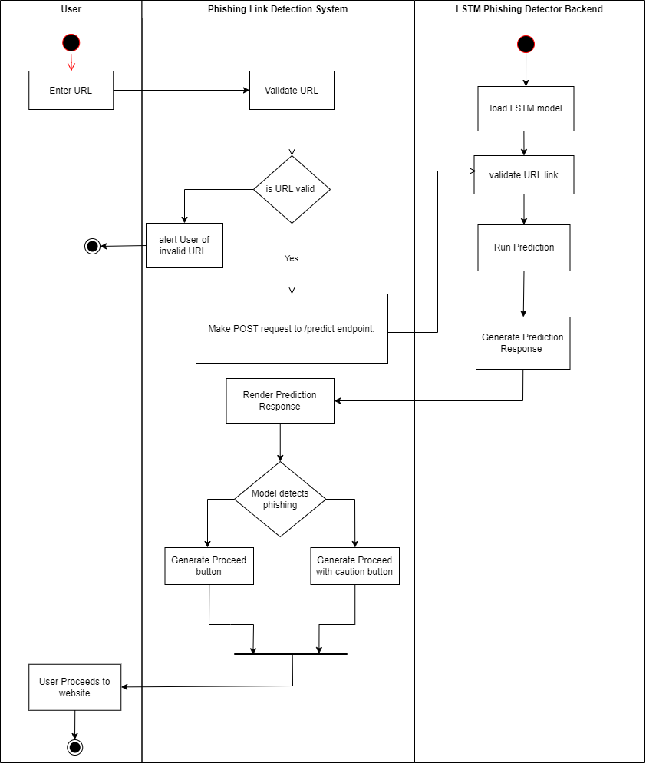
Activity Diagram
11/24/2024

Slide 19
Algorithm Details
Role of LSTM: LSTM, a type of recurrent neural network (RNN), is utilized to analyze the sequential nature of URL strings in phishing link detection.
Pattern Detection: It identifies patterns in the sequence of characters or tokens, distinguishing legitimate URLs from phishing ones.
Learning Process: LSTM learns from labeled data during training, capturing features specific to phishing attempts.
11/24/2024

Slide 20
Continue
Effectiveness: Its ability to process sequential data makes it effective in detecting subtle, suspicious URL structures.
Outcome: Provides high accuracy in identifying phishing links, enhancing the system's reliability.

Slide 21
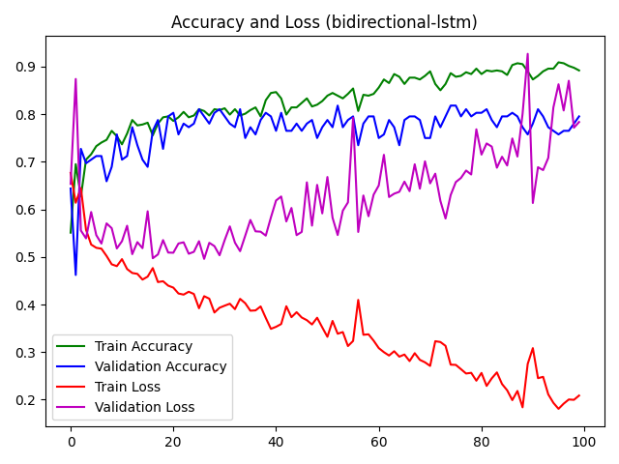
Result Analysis
11/24/2024

Slide 22
Result Analysis
The figure shows accuray and loss of model over 100 epoch with batch size of 64
Green Line: represents training accuracy, which steadily improves and reaches a high value, indicating that the model is learning well on the training data.
Blue Line: represents validation accuracy, which also improves but fluctuates more, reflecting variability in the model’s generalization to unseen data.
Red Line: shows training loss, which decreases consistently, demonstrating that the model minimizes error effectively during training.
11/24/2024

Slide 23
Continue
Magenta Line: representing validation loss, initially decreases but later fluctuates significantly, suggesting potential overfitting.
11/24/2024

Slide 24
Conclusion
The system effectively combats phishing attacks using an LSTM-based model with real-time detection
Its integration with a FastAPI backend ensures security and usability
Continuous updates address challenges like false positives and evolving threats
The project provides a strong foundation for enhancing online safety and preventing cyber threats
11/24/2024

Slide 25
References
[1] S. a. S. J. Hochreiter, "Long short-term memory," Neural computation, vol. 9, no. 1997, pp. 1735--1780, 1997.
[2] A. Sherstinsky, "Fundamentals of Recurrent Neural Network (RNN) and Long Short-Term Memory (LSTM) Network," Physica D: Nonlinear Phenomena, vol. 404, p. 43 pages, 2020.
[3] R. &. A. Rou, "ScienceDirect," PhishShield: A Desktop Application to Detect Phishing Webpages through Heuristic Approach, vol. 54, no. 2015, pp. 147-156, 2015.
[4] "easydmarc.," [Online]. Available: https://easydmarc.com/tools/phishing-url. [Accessed 10 August 2024].

Slide 26
Thank you!

